Slide 1
Web Programming
Dr. Leninisha Shanmugam
Asso Prof SCOPE
7k60k2r

Slide 2
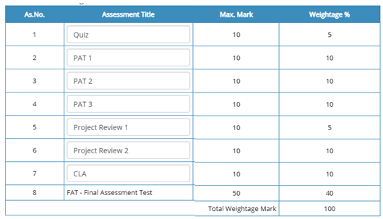

Slide 3
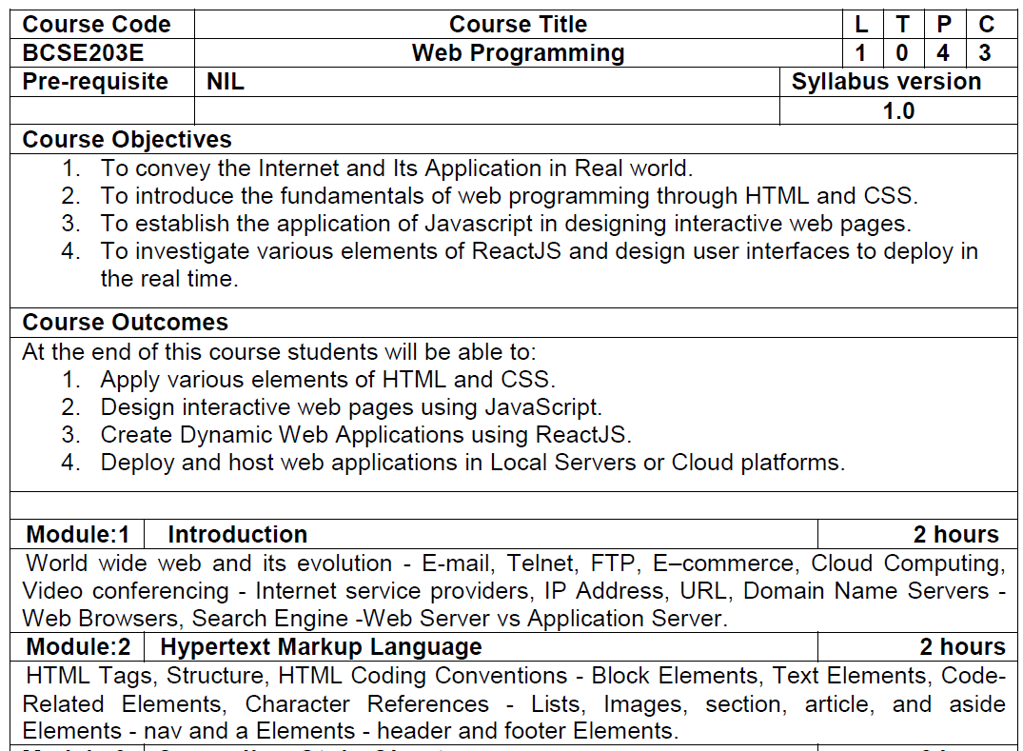
Syllabus

Slide 4
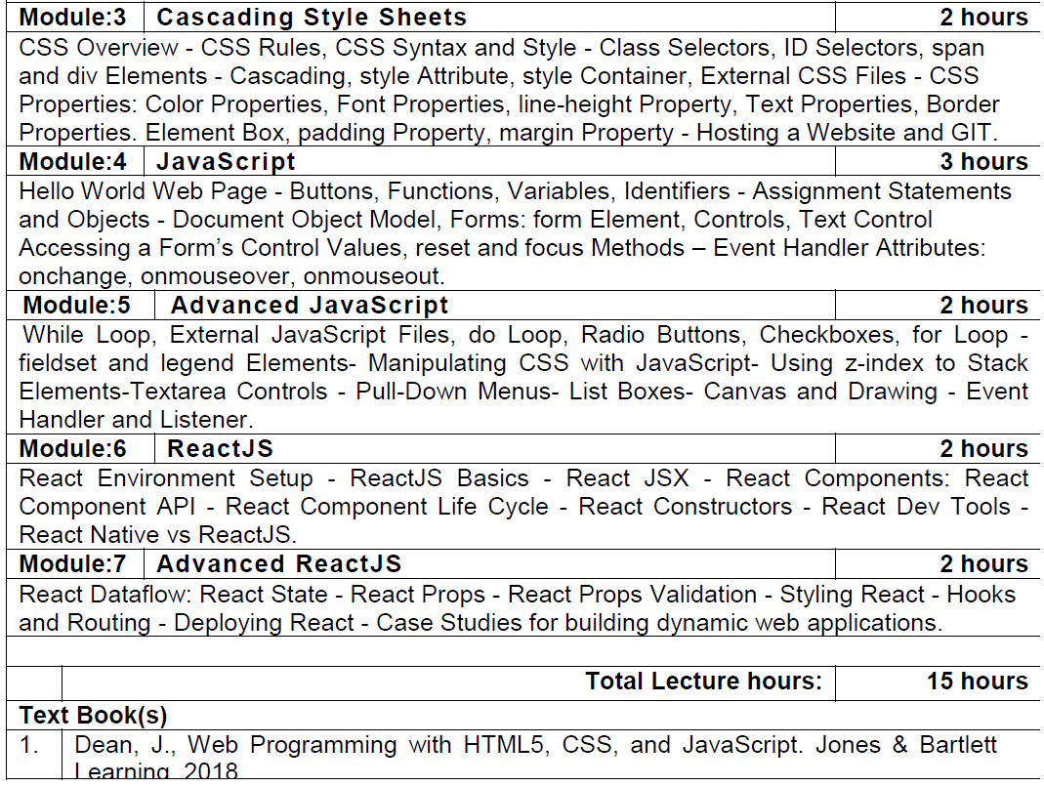
Syllabus

Slide 5
Power of Web Programming
E-Commerce and Online Shopping
Websites like Amazon, Flipkart, and eBay use web programming to offer seamless shopping experiences.
Communication and Collaboration
Platforms like Gmail, Slack, Microsoft Teams, and WhatsApp Web are built using web programming.
Social Networking and Media
Applications like Facebook, Instagram, Twitter, and LinkedIn revolutionize how people connect, share, and interact.
Entertainment and Streaming
Services like Netflix, YouTube, and Spotify rely on web technologies for video/audio streaming.

Slide 6
Power of Web Programming
Education and Learning
Platforms like Coursera, Khan Academy, and edX use web programming to deliver online courses.
Financial Services and Banking
Online banking, payment apps (e.g., PayPal, Stripe, Google Pay), and stock trading platforms use secure web programming.
Healthcare and Telemedicine
Applications like Practo and hospital portals allow patients to book appointments, access records, and consult doctors online.
Telemedicine platforms use web technologies for secure video calls and sharing sensitive medical data.
Transportation and Logistics
Apps like Uber, Ola, and Swiggy use web programming for booking, tracking, and route optimization.

Slide 7
Basics of HTML
HTML – Hyper Text Markup Language
1991, Tim Berners-Lee invented HTML
HTML is not a programming language, It is a Markup Language
It consist of markup tags, which describes how text should be displayed in the web page
HTML elements tell the browser how to display the content
HTML is not case sensitive language
HTML used to create static websites

Slide 8
Let’s begin with HTML
Hypertext refers to text that contains links to other pieces of text or content, enabling users to navigate between documents or sections by clicking on hyperlinks.
A Markup Language is a system used to structure and present data in documents, particularly for the web.
It uses a set of rules to annotate text in a way that specifies how it should be displayed, formatted, or structured. These annotations are called tags or markup.

Slide 9
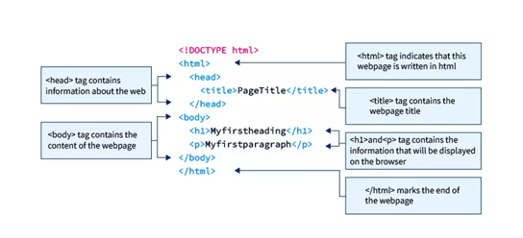

Slide 10
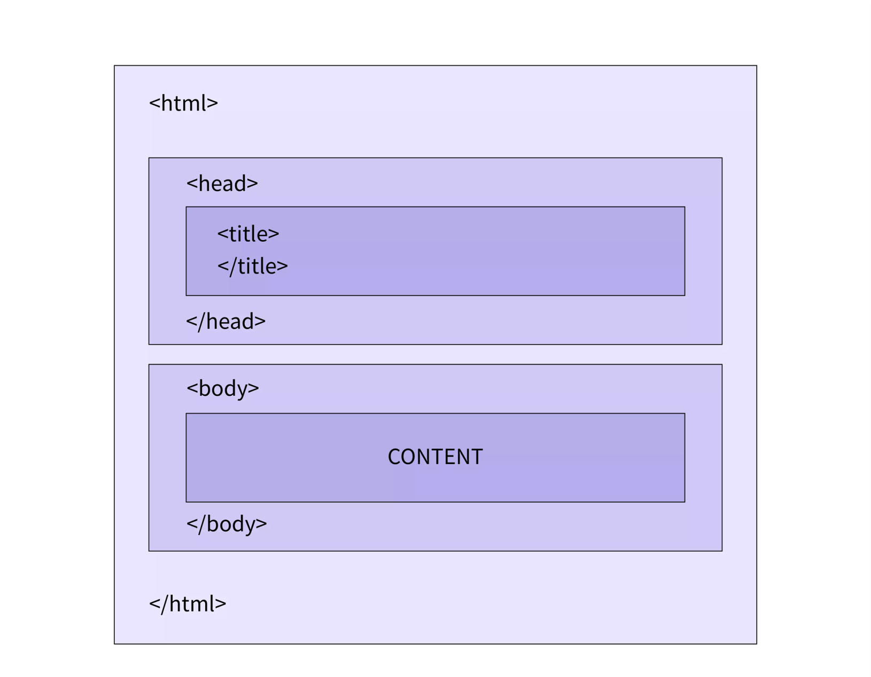

Slide 11
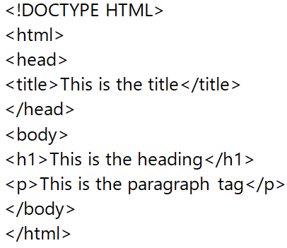
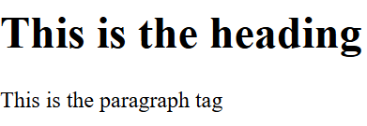
HTML

Slide 12
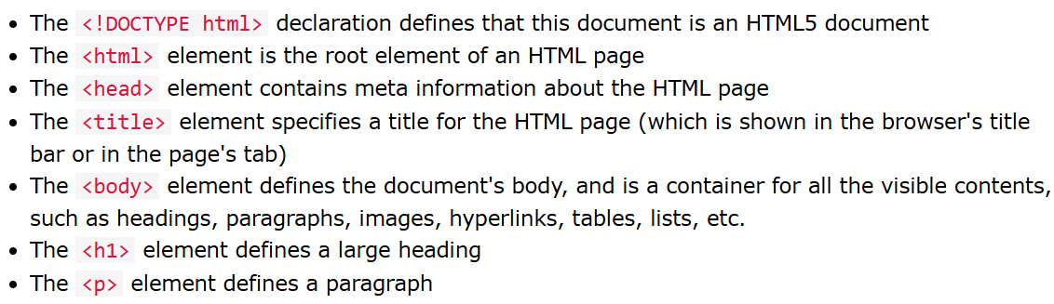
HTML

Slide 13
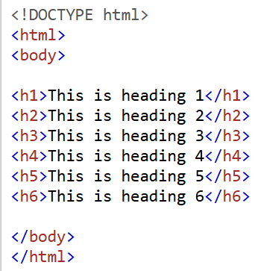
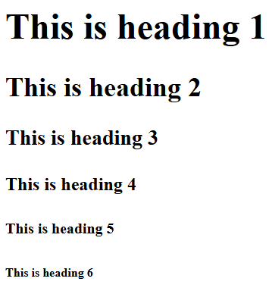
HTML

Slide 14
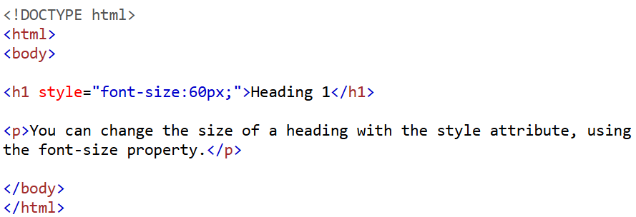
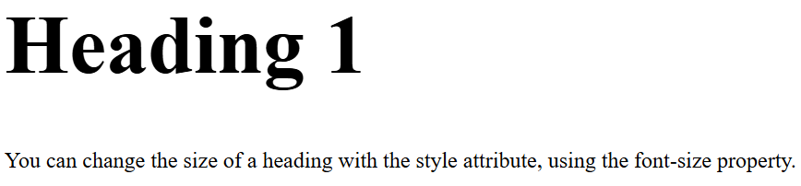
HTML

Slide 15
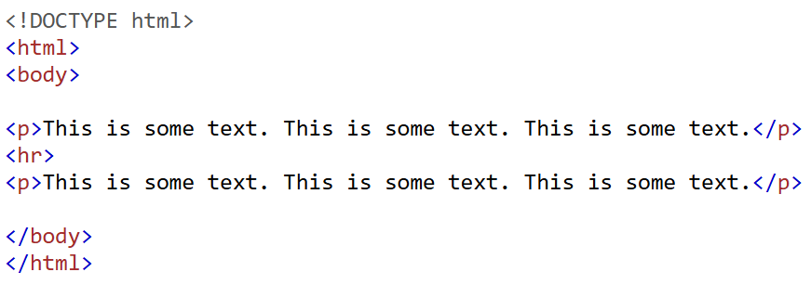
HTML

Slide 16
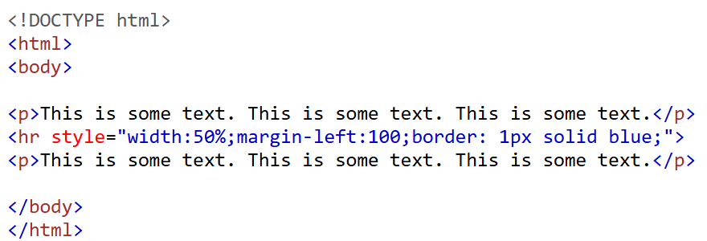
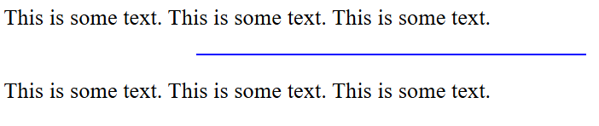
HTML

Slide 17
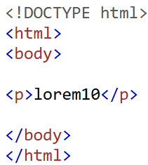
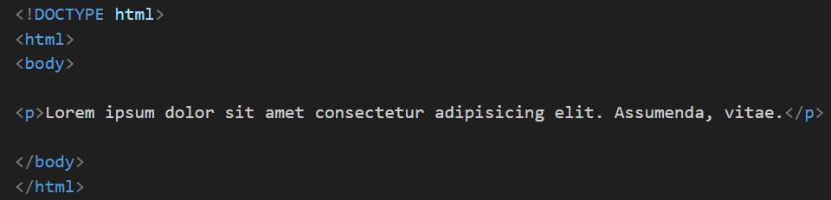
HTML

Slide 18
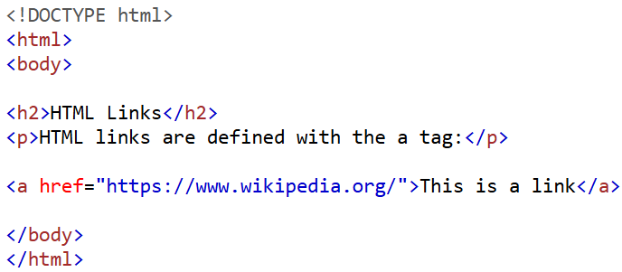
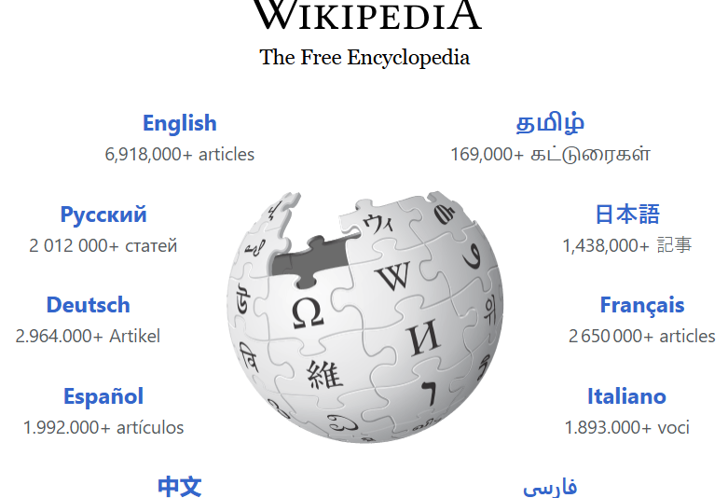
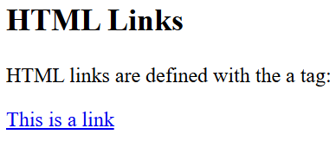
HTML

Slide 19
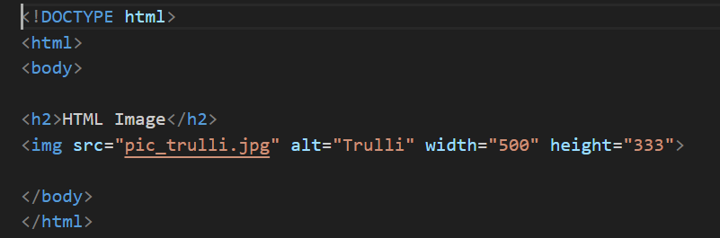

HTML

Slide 20
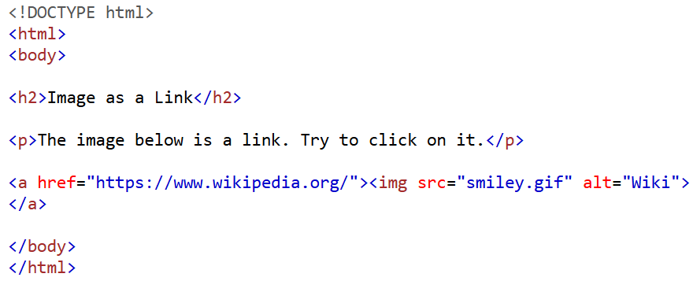
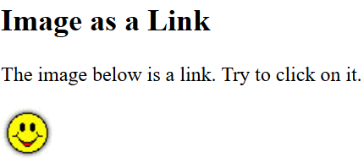
HTML

Slide 21
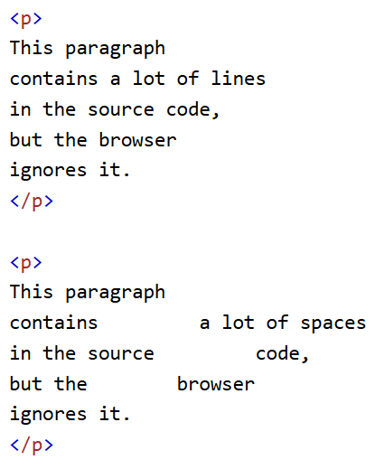
HTML

Slide 22
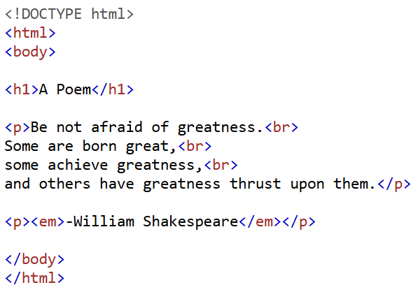
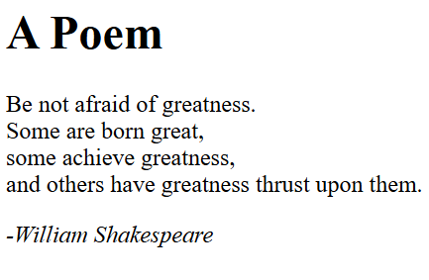
HTML

Slide 23
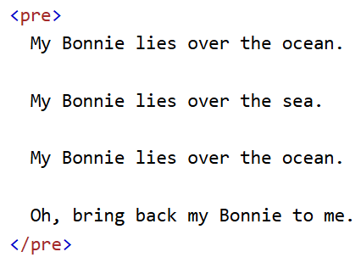
HTML

Slide 24
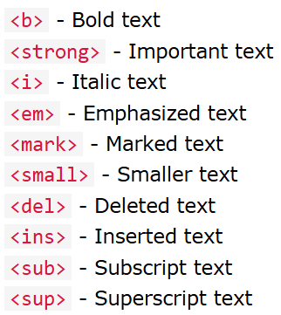
HTML

Slide 25
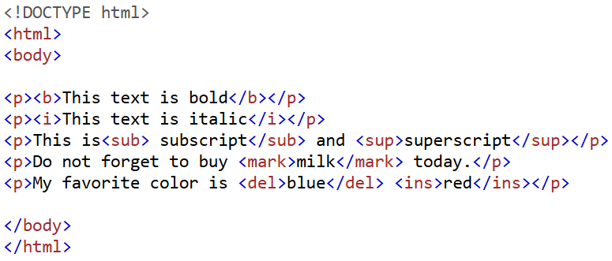
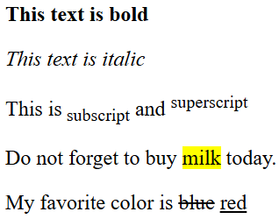
HTML

Slide 26
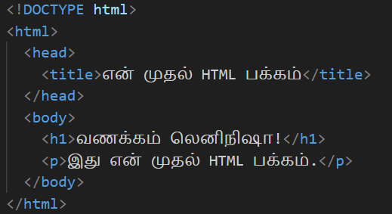
HTML
வணக்கம் லெனிநிஷா!
இது என் முதல் HTML பக்கம்.

Slide 27
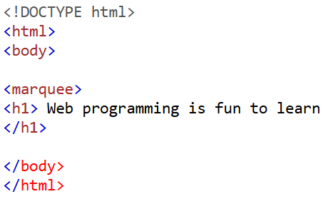
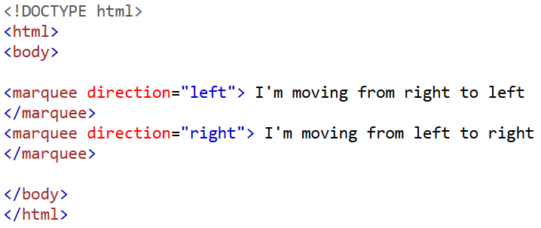
HTML

Slide 28
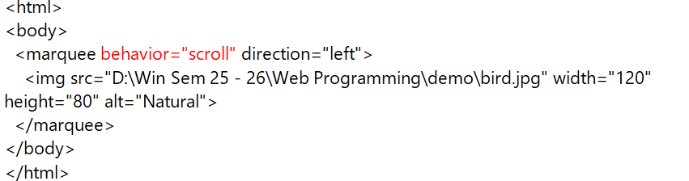
HTML
behavior=“slide"
behavior="alternate"
behavior="scroll" direction="up"
behavior="scroll" direction="left" scrollamount="5"

Slide 29
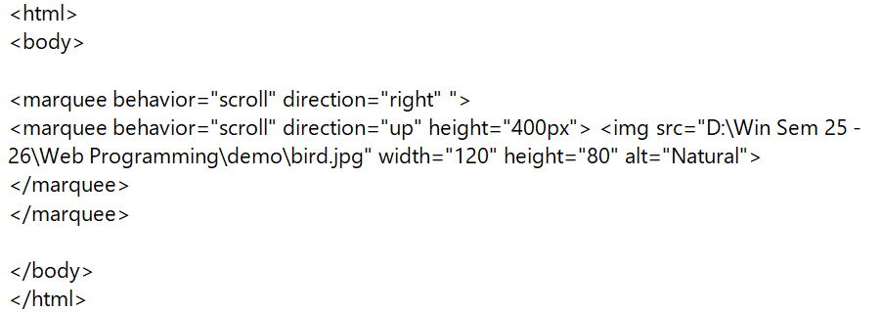
HTML

Slide 30
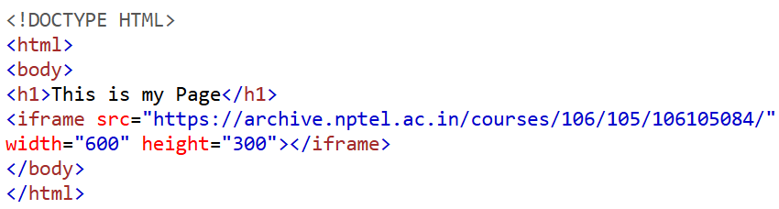
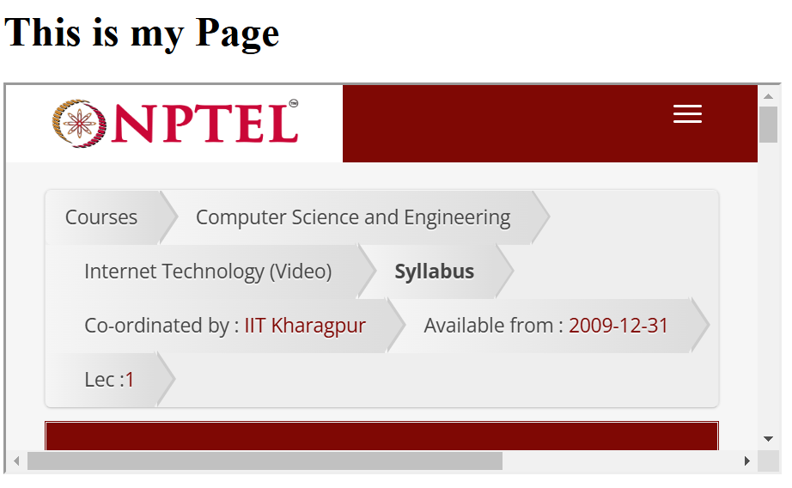
HTML

Slide 31
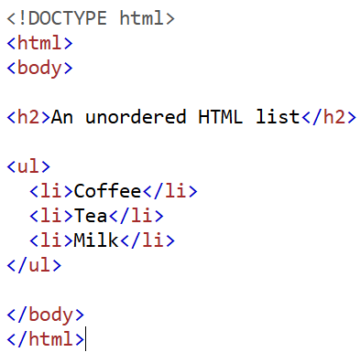
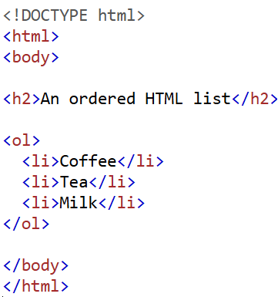
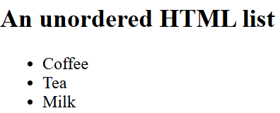
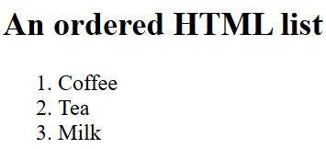
HTML

Slide 32
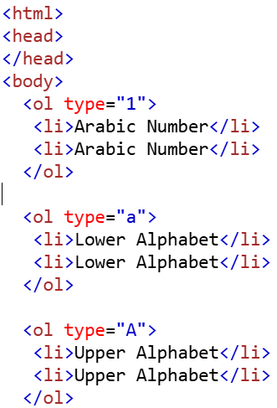
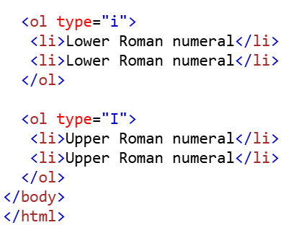
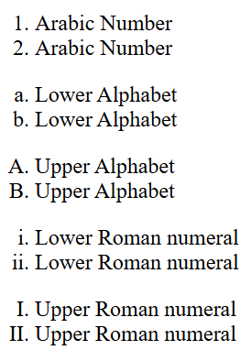
HTML

Slide 33
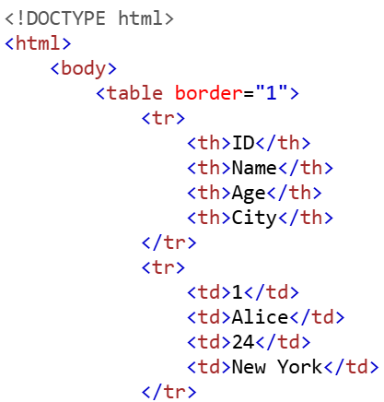
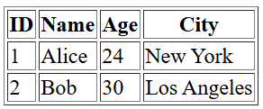
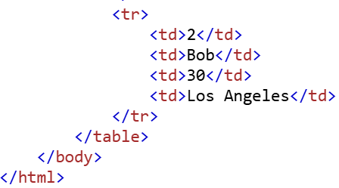
HTML

Slide 34
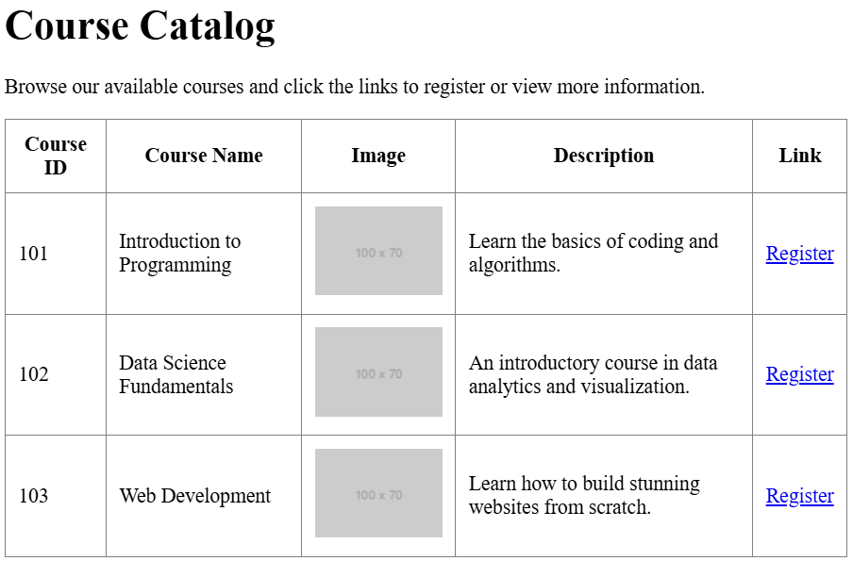
HTML

Slide 35
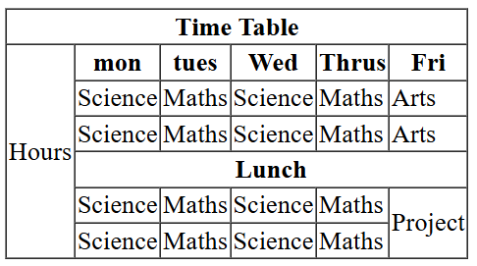
HTML

Slide 36
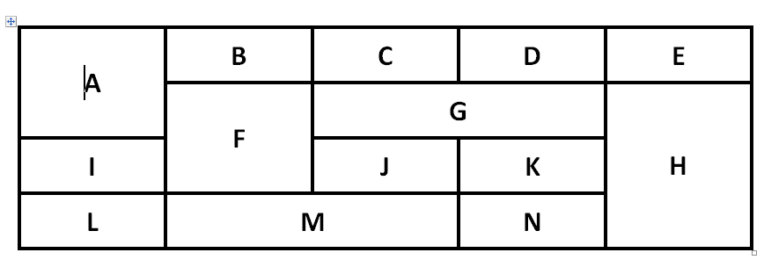
HTML

Slide 37

HTML

Slide 38
HTML
<thead>
The <thead> remains visible when scrolling through a long list of data.
<tbody>
The table header stays always visible.
Users can scroll within the table itself without moving the whole page.
<tfoot>
The footer remains visible even when scrolling through large datasets.
The footer can have a different background color to highlight totals.

Slide 39


HTML

Slide 40


HTML

Slide 41

HTML

Slide 42


HTML

Slide 43

HTML

Slide 44


HTML-Character References

Slide 45



HTML

Slide 46




HTML

Slide 47


HTML

Slide 48




HTML

Slide 49

HTML

Slide 50

HTML

Slide 51


Animation Using HTML

Slide 52


Animation Using HTML

Slide 53



HTML

Slide 54




HTML

Slide 55


HTML

Slide 56


HTML

Slide 57



HTML

Slide 58



HTML

Slide 59



HTML

Slide 60


HTML

Slide 61




HTML

Slide 62



HTML

Slide 63

HTML
post: We can use the post value of method attribute when we want to process the sensitive data as it does not display the submitted data in URL.

Slide 64
HTML
get: The get value of method attribute is default value while submitting the form. But this is not secure as it displays data in URL after submitting the form
_self: If we use _self as an attribute value, then the response will display in current page only
_blank: If we use _blank as an attribute it will load the response in a new page

Slide 65

HTML

Slide 66

HTML

Slide 67

HTML- Project

Slide 68

HTML

